Slide 1
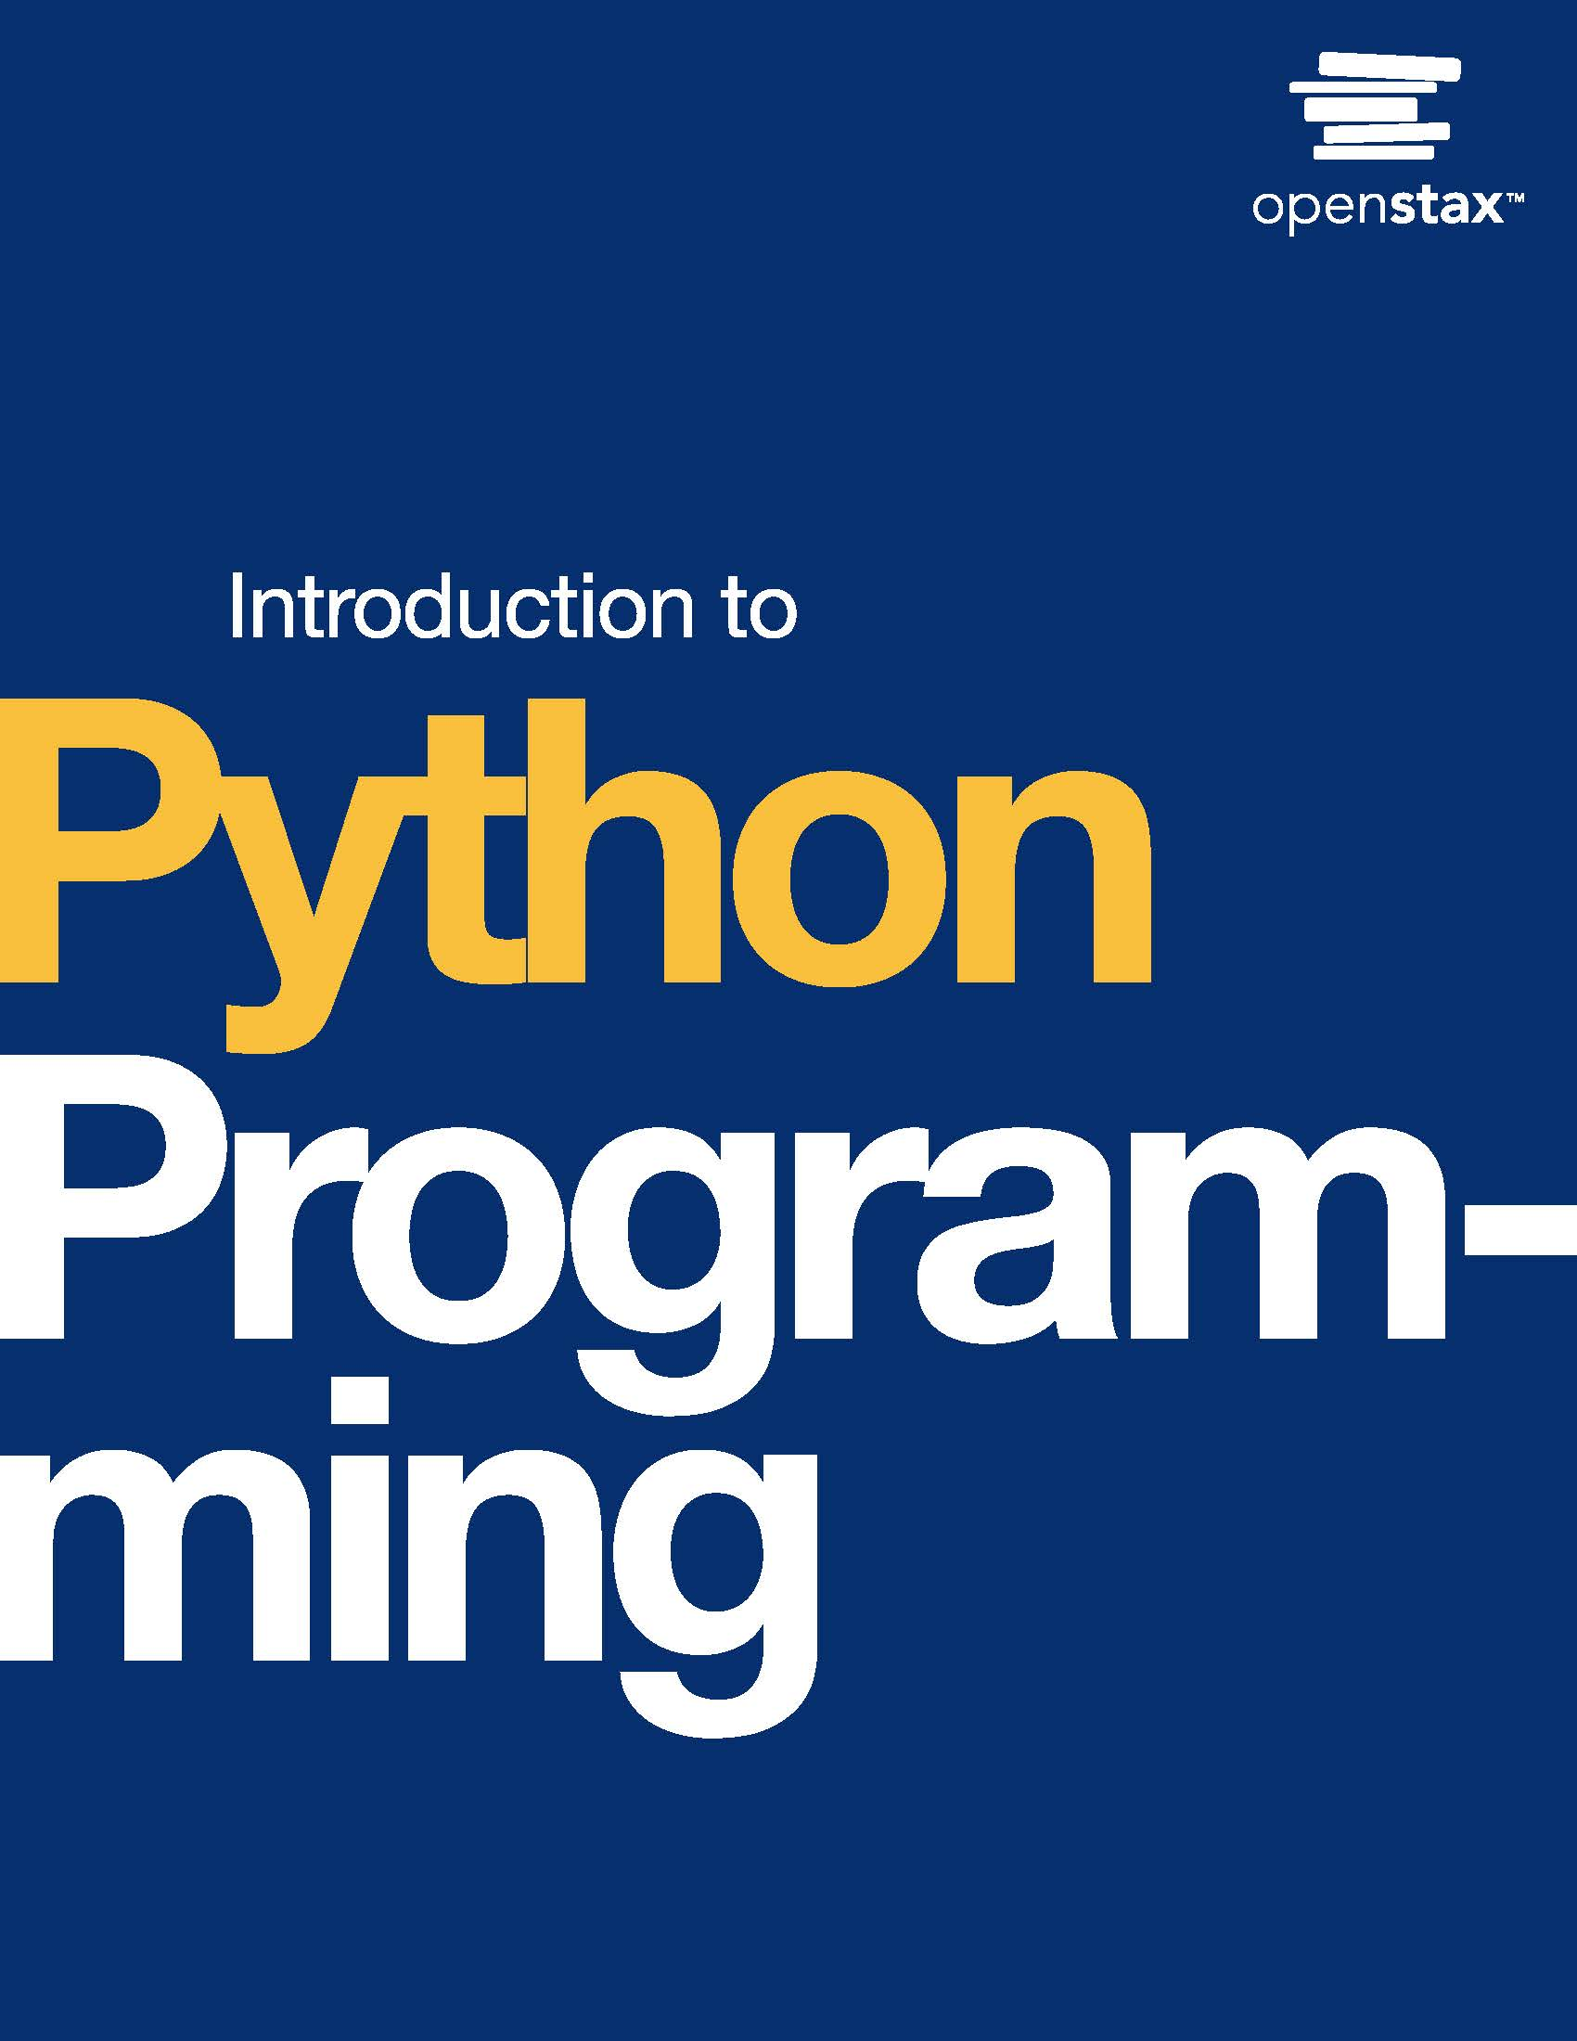
Introduction to Python Programming
Chapter 9: Lists

Slide 2
Chapter outline
Modifying and iterating lists
Sorting and reversing lists
Common list operations
Nested lists
List comprehensions

Slide 3

Figure 9.1
credit: modification of work "Budget and Bills" by Alabama Extension/Flickr, Public Domain
Notes:
A photo of a notepad and a pen. The notepad says "Budget" across the top, with a numbered list below…

Slide 4
9.1 Modifying and iterating lists
Learning Objectives
Modify a list using append(), remove(), and pop() list operations.
Search a list using a for loop.

Slide 5
9.1 Modifying and iterating lists
An append() operation is used to add an element to the end of a list. In programming, append means add to the end.
A remove() operation removes the specified element from a list.
A pop() operation removes the last item of a list.

Slide 6
9.1 Modifying and iterating lists
An iterative for loop can be used to iterate through a list.
Alternatively, lists can be iterated using list indexes with a counting for loop. The animation below shows both ways of iterating a list.

Slide 7
9.2 Sorting and reversing lists
Learning Objectives
Understand the concept of sorting.
Use built-in sort() and reverse() methods.

Slide 8
9.2 Sorting and reversing lists
Ordering elements in a sequence is often useful.
Sorting is the task of arranging elements in a sequence in ascending or descending order.
Sorting can work on numerical or non-numerical data.
When ordering text, dictionary order is used.
Ex: "bat" comes before "cat" because "b" comes before "c".

Slide 9
9.2 Sorting and reversing lists
Using sort() and reverse()
Python provides methods for arranging elements in a list.
The sort() method arranges the elements of a list in ascending order. For strings, ASCII values are used and uppercase characters come before lowercase characters, leading to unexpected results.
Ex: "A" is ordered before "a" in ascending order but so is "G"; thus, "Gail" comes before "apple".
The reverse() method reverses the elements in a list.

Slide 10
9.3 Common list operations
Learning Objectives
Use built-in functions max(), min(), and sum().
Demonstrate how to copy a list.

Slide 11
9.3 Common list operations
The max() function called on a list returns the largest element in the list.
The min() function called on a list returns the smallest element in the list. The max() and min() functions work for lists as long as elements within the list are comparable.
The sum() function called on a list of numbers returns the sum of all elements in the list.

Slide 12
9.4 Nested lists
Learning Objectives
Demonstrate the use of a list-of-lists to structure data.
Demonstrate individual element addressing using multi-dimensional indexing.
Use nested loops to iterate a list-of-lists.

Slide 13
9.4 Nested lists
Lists can be made of any type of element.
A list element can also be a list. Ex: [2, [3, 5], 17] is a valid list with the list [3, 5] being the element at index 1.
When a list is an element inside a larger list, it is called a nested list. Nested lists are useful for expressing multidimensional data.
When each of the elements of a larger list is a smaller list, the larger list is called a list-of-lists.
Ex: A table can be stored as a two-dimensional list-of-lists, where each row of data is a list in the list-of-lists.

Slide 14
9.5 List comprehensions
Learning Objectives
Identify the different components of a list comprehension statement.
Implement filtering using list comprehension.

Slide 15
9.5 List comprehensions
A list comprehension is a Python statement to compactly create a new list using a pattern.
The general form of a list comprehension statement is shown below.
list_name = [expression for loop_variable in iterable]
list_name refers to the name of a new list, which can be anything, and the for is the for loop keyword. An expression defines what will become part of the new list.
loop_variable is an iterator, and iterable is an object that can be iterated, such as a list or string.

Slide 16
9.5 List comprehensions
List comprehensions can be used to filter items from a given list. A condition is added to the list comprehension.
list_name = [expression for loop_variable in container if condition]
In a filter list comprehension, an element is added into list_name only if the condition is met.

Slide 17
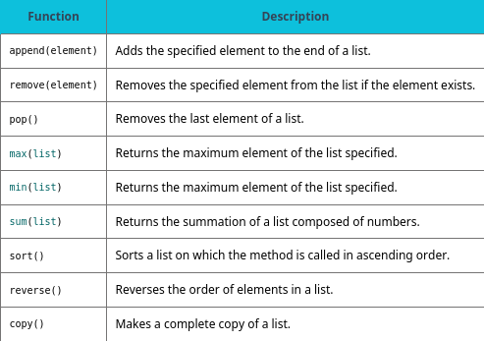
Table 9.1 Chapter 9 reference.

Slide 18
This ancillary resource is licensed under a Creative Commons Attribution-NonCommercial-ShareAlike 4.0 (CC BY NC-SA) license; it may be distributed, remixed, built upon for noncommercial purposes only, and must be attributed to OpenStax and redistributed under the same license.

